Slide 1
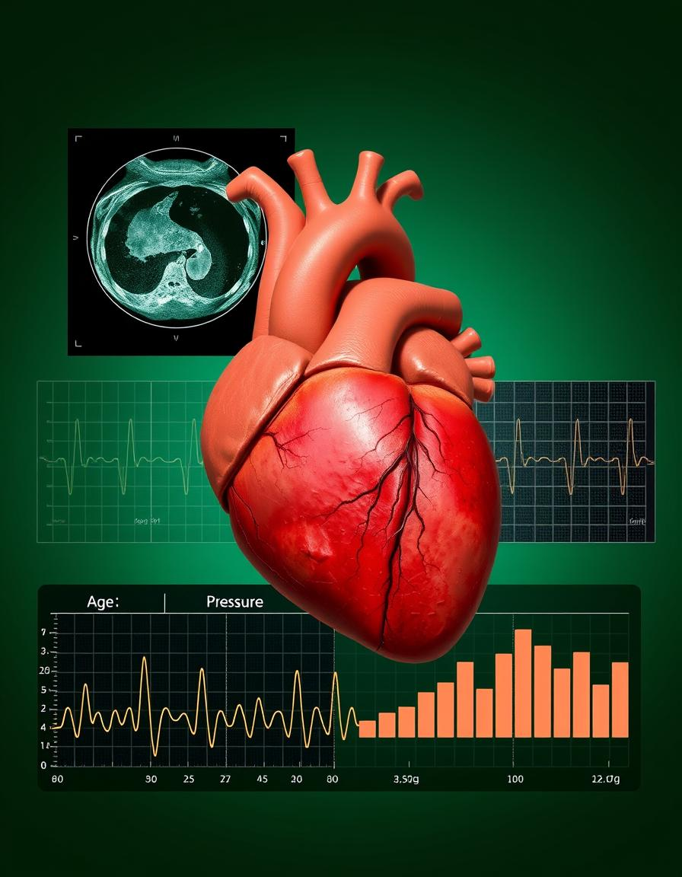
Integrating Machine Learning with Real-Time Electronic Health Record Systems for the Prognosis and Diagnosis of Cardiovascular Diseases
04.17.25
Presenters: Dennis Owusu & Syllas Otutey
Instructor: Dr. Guy Hembroff
Course name: AI In Healthcare

Slide 2
Introduction
Cardiovascular disease (CVD) is the leading cause of death worldwide, accounting for approximately 17.9 million deaths each year, which is about 32% of all global deaths according to the World Health Organization. Of these, over 75% occur in low- and middle-income countries, highlighting the urgent need for early detection and effective intervention strategies.
Problem Statement
Despite advancements in medical technology, the early detection of cardiovascular disease remains challenging due to the complexity and volume of patient data. Traditional diagnostic methods often fail to identify at-risk individuals in time, leading to delayed interventions and increased mortality.
Research Objective
To develop and integrate machine learning models with real-time electronic health record (EHR) systems to enhance the early detection, diagnosis, and prognosis of cardiovascular diseases. This approach aims to support clinicians with accurate, data-driven insights that enable timely and personalized medical interventions.

Slide 3
Literature Review
1.Machine Learning in CVD Risk Prediction: ML models like logistic regression and random forests can predict CVD risk more accurately than traditional methods (e.g., Framingham Risk Score) [Alaa et al., 2019].
2. Deep Learning for Diagnosis: CNNs and RNNs improve cardiovascular diagnosis, such as arrhythmias, by analyzing ECGs [Hasan et al., 2019].
3. Real-Time Decision Support: ML models integrated with EHR systems can provide real-time decision support for conditions like sepsis and heart failure [Rajkomar et al., 2018].
4. Model Interpretability: Ensuring ML models' interpretability, such as using SHAP, is vital for clinical adoption [Caruana et al., 2015; Lundberg et al., 2018].
5. Challenges in EHR Integration: Issues like missing data and unstructured formats need to be addressed for effective ML integration into EHR systems [Shickel et al., 2018].
6. Wearable Devices: Data from wearable devices can enhance CVD risk prediction and enable continuous monitoring [Banaee et al., 2013].

Slide 4
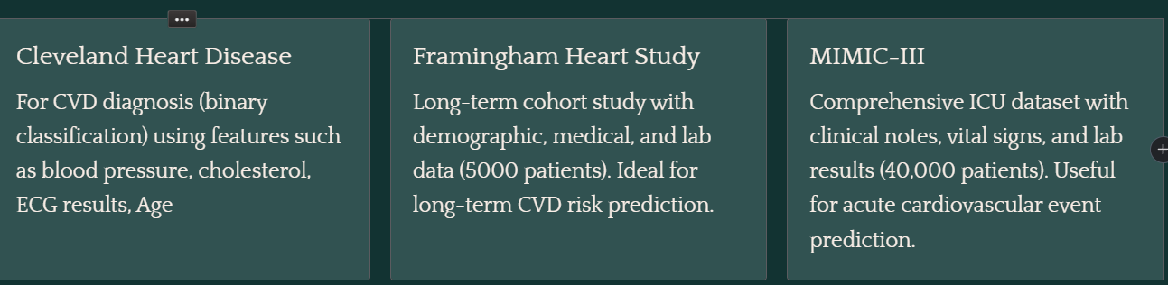
Dataset Selection

Slide 5
Data Preprocessing and Feature Engineering
Data Preprocessing
Cleaning: Handling missing values and Removing outliers
Normalization: Scaling numerical features for optimal model performance
Categorical encoding: Converting categorical variables into numerical format using one-hot encoding
Feature Engineering
Extracting relevant features: Age, blood pressure, cholesterol levels
Creating interaction features: Combining risk factors to improve model accuracy

Slide 6
Model Selection and Training
Logistic Regression: Simple and interpretable model for binary classification
Random Forest: Robust ensemble methods that handles large dataset and captures non-linear relationships
Support Vector Machine (SVM): Effective for high-dimensional data
Neural Networks (MLPClassifier): Useful for handling large dataset and improve accuracy in high-dimensional space.
HYPERPARAMETER TUNING
Logistic regression
Max_iter=1000 explicitly set
Random Forest
n_estimators = 100
random_state = 42
SVM
max_ite r =1000
Neural Network (MLPClassifier)
Activation = ReLu,TanH
Learning rate = constant, adaptive
max_iter = 1000

Slide 7
Evaluation Metrics
Accuracy: Measures the overall correctness of the model in predicting both healthy and at-risk patients.
Precision: Ensures the model correctly identifies patients with cardiovascular disease without over-predicting false positives
Recall: Captures the model's ability to detect actual CVD cases, minimizing missed diagnoses.
AUC-ROC: Evaluates how well the model distinguishes between patients with and without cardiovascular disease across all thresholds.

Slide 8
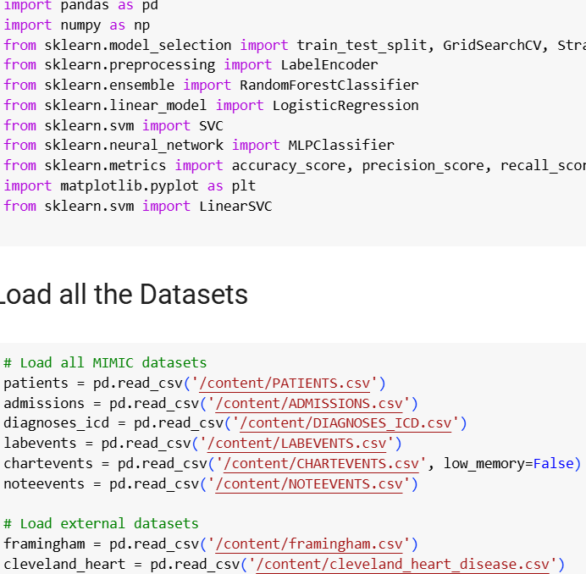
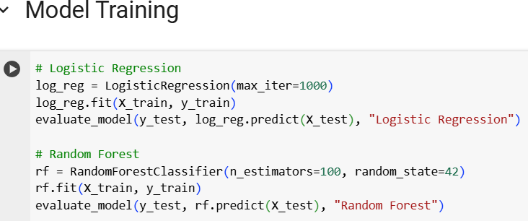
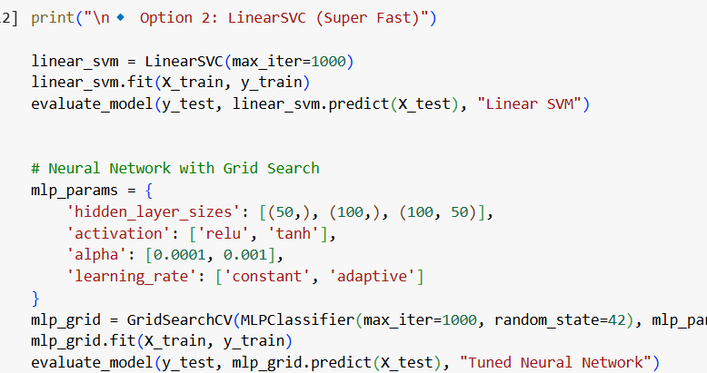
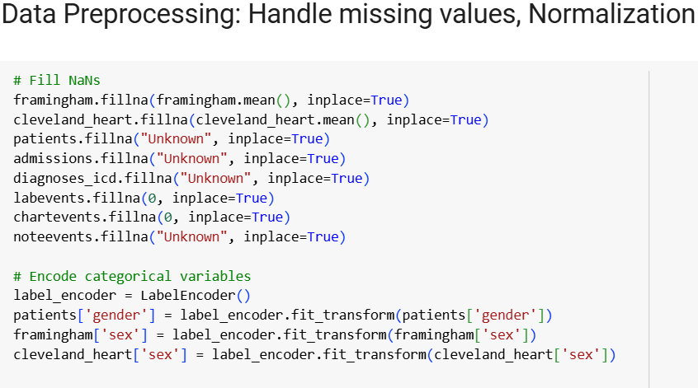
MODEL ALGORITHM

Slide 9
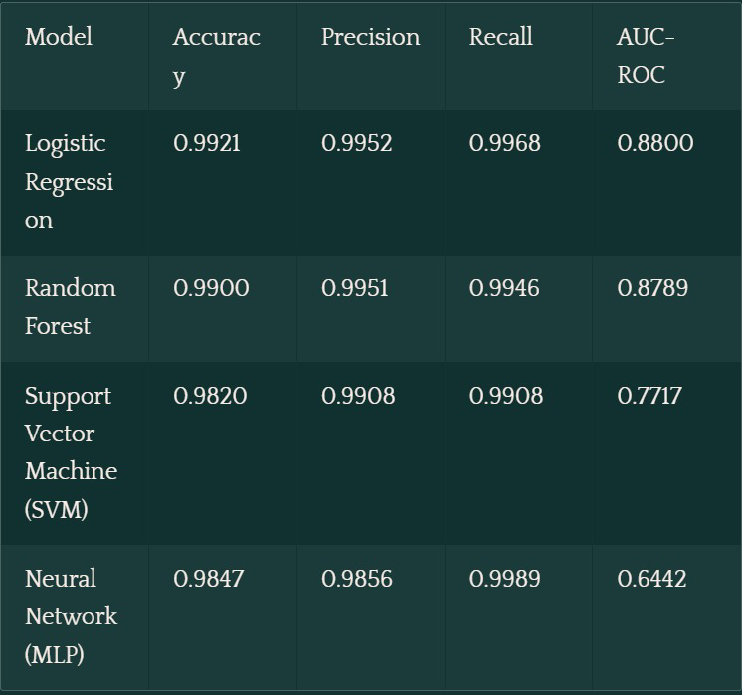
MODELS PERFORMANCE

Slide 10
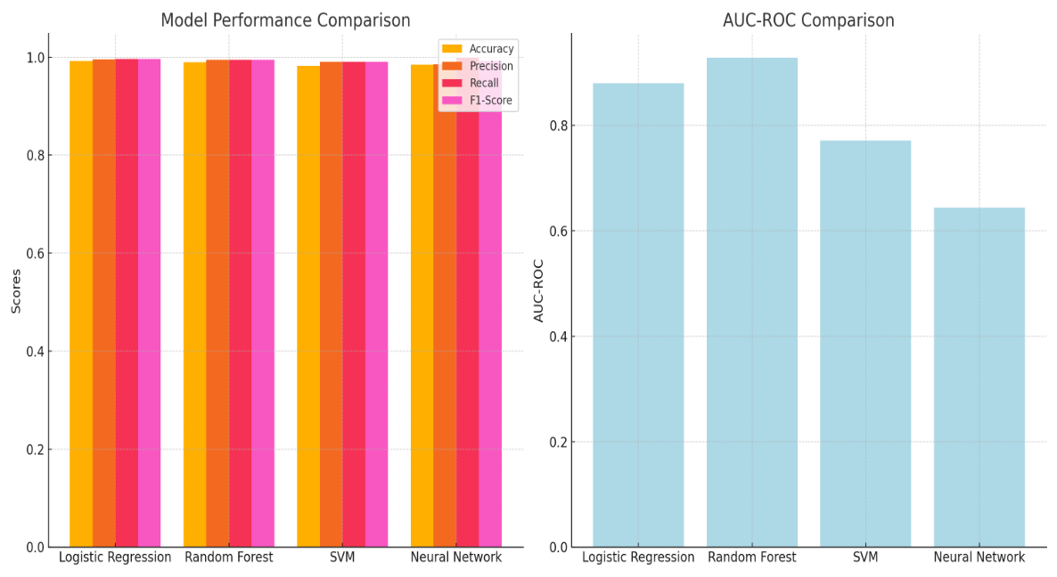
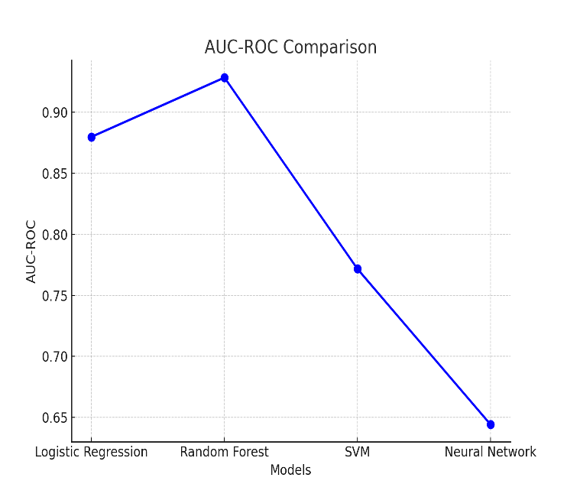
MODELS PERFORMANCE

Slide 11
Discussion
Logistic Regression (99.21%) and Random Forest (99%) performed the best with high accuracy and strong detection capabilities.
SVM showed good precision and recall but lower AUC-ROC.
The Neural Network had the highest recall, indicating exceptional sensitivity, but its lower AUC suggested challenges in distinguishing between classes.
Challenges
Data quality, missing values, and model interpretability.

Slide 12
Conclusion
This project demonstrated the potential of integrating machine learning with real time EHR systems for the diagnosis and prognosis of cardiovascular diseases. The models showed promising performance, with Logistic regression and Random Forest offering the best results in terms of accuracy and precision.
Future works
Clinical deployment
Introduction of Explainable AI such as SHAP and LIME- To explain how or why a model made a prediction to assist healthcare providers in clinical decision making.
Ensure Model Interoperability

Slide 13
References
1. Alaa, A. M., Bolton, T., Di Angelantonio, E., Rudd, J. H. F., & van der Schaar, M. (2019). Cardiovascular disease risk prediction using automated machine learning: A prospective study of 423,604 UK Biobank participants. PLOS ONE, 14(5), e0213653. https://doi.org/10.1371/journal.pone.0213653
2.Hasan, N. I., & Bhattacharjee, A. (2019). Convolutional neural networks for arrhythmia detection from ECG data: A systematic review. Biomedical Signal Processing and Control, 52, 1-13. https://doi.org/10.1016/j.bspc.2019.04.005
3.Weng, S. F., Reps, J., Kai, J., Garibaldi, J. M., & Qureshi, N. (2017). Can machine-learning improve cardiovascular risk prediction using routine clinical data? PLOS ONE, 12(4), e0174944. https://doi.org/10.1371/journal.pone.0174944
4.Rajkomar, A., Oren, E., Chen, K., et al. (2018). Scalable and accurate deep learning for electronic health records. npj Digital Medicine, 1, 18.
5.Caruana, R., Gehrke, J., Koch, P., et al. (2015). Intelligible models for healthcare: Predicting pneumonia risk and hospital 30-day readmission. Proceedings of the 21st ACM SIGKDD International Conference on Knowledge Discovery and Data Mining, 1721-1730.

